Slide 1



Chat Analyzer
Using Python
Team Members
❏ Anant Kansal (240810125006)
❏ Kamesh Kushwah (240810125001)
❏ Vivek Kumar (240810125011)
Project Guide
❏ Mr. Sunil Kumar
Group No. 2

Slide 2
Table of contents
01 Objective
Flow Chart
Result Analysis
Future Scope
Conclusion
Introduction
Methodology
Requirements Speciﬁcations
04

Slide 3

Objective
This project develops a user-friendly Chat Analyzer for whatsapp. It extracts and analyzes conversation data, including timestamps, senders, and messages. The analyzer calculates individual activity metrics (message count, active hours) and overall chat statistics (media, peak times). Word clouds visualize frequent vocabulary, and emoji usage is analyzed.
Sentiment analysis uses machine learning, and interactive visualizations explore conversation patterns.

Slide 4
Introduction
This project developed a user-friendly Chat Analyzer for whatsapp to extract insights from conversation data. It automates analysis, extracting key information like timestamps and sender data to analyze individual activity (message frequency, active hours) and overall chat statistics (peak activity, common vocabulary, emoji use). Sentiment analysis and interactive visualizations present results, revealing communication dynamics and trends. The analyzer simplifies understanding WhatsApp conversations, offering actionable insights through clear visualizations.

Slide 5
Methodology
Chat logs (eg. whatsapp .txt) were preprocessed using regular expressions to extract timestamps and messages, removing notifications and generating time-based features (day, date, hour). Stop words were removed, and feature extraction calculated word frequencies, emoji counts, and participant metrics (message count, active hours). Visualizations (word clouds, bar charts, line graphs) represented frequent words, message frequency, and chat activity. Python, nltk, matplotlib, and seaborn were used for implementation and analysis.

Slide 6


Requirements Speciﬁcations
Hardware Requirements
❏ Processor: Intel i3 or equivalent.
❏ RAM: Minimum 4
GB.
❏ Storage: 10-20 GB free space.
❏ Network: Stable
internet connection.
Software Requirements
❏ Python 3.x, Pandas.
❏ Streamlit, Matplotlib, seaborn, word cloud, urlextract, preprocessor etc..
❏ PyCharm,
scikit-learn, Regular Expressions (re) library.
Other Tools Requirements
❏ Streamlit cloud.
❏ Github..

Slide 7
Flow Chart

Slide 8

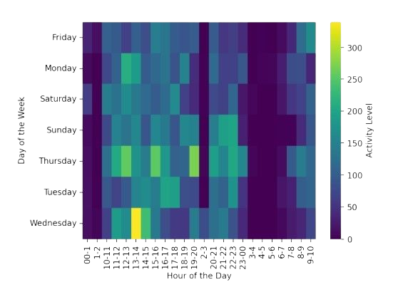
Result Analysis
Heat Map for Chat Density Hour to Hour
This heatmap visualizes weekly chat activity, correlating days and hours to show peak conversation times. Warmer colors indicate higher message frequency, revealing active periods like Wednesday/Thursday afternoons and evenings. Cooler colors represent less activity, pinpointing quieter times. The visualization helps identify when the group is most engaged, offering insights into communication patterns.

Slide 9
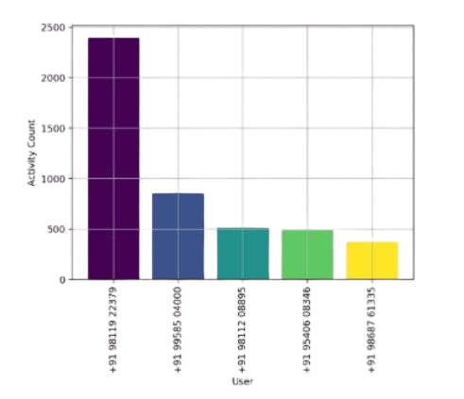
Most Busy Users by Using Bar Chart
This bar chart ranks top chat contributors by message count. The vertical axis shows the number of messages, and the horizontal axis lists users. Bar height indicates message frequency, revealing the most active participants. It visually compares user activity levels and contribution to the conversation.

Slide 10
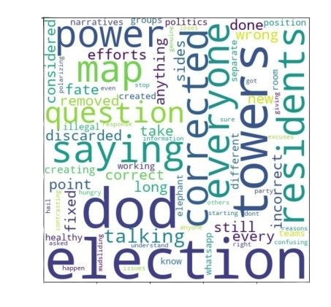
Most Frequent Words Using Word Cloud
This word cloud visualizes frequent chat terms, with size indicating importance. Larger words like "done," "map," "power," and "residents" suggest recurring topics. It provides a quick overview of prevalent themes and keywords. The visualization helps identify core vocabulary and dominant subjects.

Slide 11
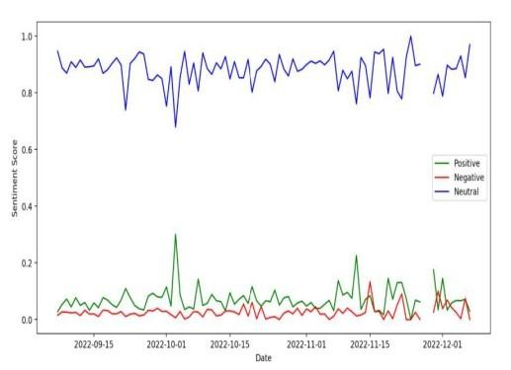
Sentiments Trend Over Time Using Time Series
This time series chart visualizes sentiment trends (positive, negative, neutral) over time (September to December). The horizontal axis shows the date, and the vertical axis shows the sentiment score. Three lines represent each sentiment category, revealing fluctuations and temporal patterns. It highlights shifts in emotional tone, showing the consistent dominance of neutral sentiment.

Slide 12
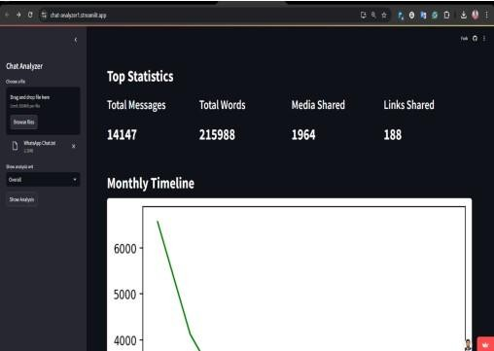
Web Page User Interface

Slide 13
Future Scope
Future enhancements include expanding platform compatibility, integrating advanced NLP (topic modeling, NER), and developing
user-defined filters. Incorporating machine learning for predictive analysis (e.g., trend forecasting) and real-time analysis with granular sentiment analysis are planned. Multimedia content analysis and enhanced UI with interactive dashboards are potential extensions. API integrations for seamless data import/export would streamline the workflow.

Slide 14
Conclusion
This project created a user-friendly WhatsApp Chat Analyzer, extracting and visualizing conversation data for valuable insights. It processes logs, calculating individual/overall statistics (message counts, active hours, peak times) and performing sentiment analysis with word clouds. Interactive visualizations (timelines, activity maps, charts) via Streamlit help users explore patterns and trends. The project transforms raw data into actionable insights, revealing communication dynamics and emotional tone. Future work may include platform expansion, advanced NLP, and more features.

